Slide 1
Stock Market Liquidity and Firm Dividend Policy
Suman Banerjee
Vladimir A. Gatchev
Paul A. Spindt
Presenter 周立軒

Slide 2
Agenda
Intuition
Sample & Variables
Empirical Result
Conclusion

Slide 3
Intuition
In MM’s world, Cash Dividend and Liquidity are irrelevant.
If investors want cash, they can directly sell stock
“Homemade Dividend”
What if the market exist “Friction” ?

Slide 4
Intuition
If Trading Friction exist, investors well demand “Compensation” for the risk.
Market is imperfect
Liquidity is one of the most effective factor

Slide 5
Intuition
So, follow this logic, firms well take Liquidity into account for dividend paying.
Furthermore, the link between Liquidity and Dividend Policy is examined here.

Slide 6
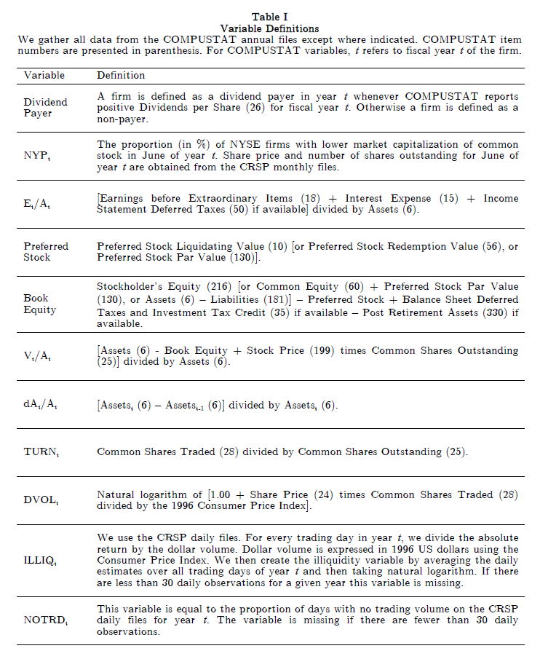
Sample & Variable

Slide 7
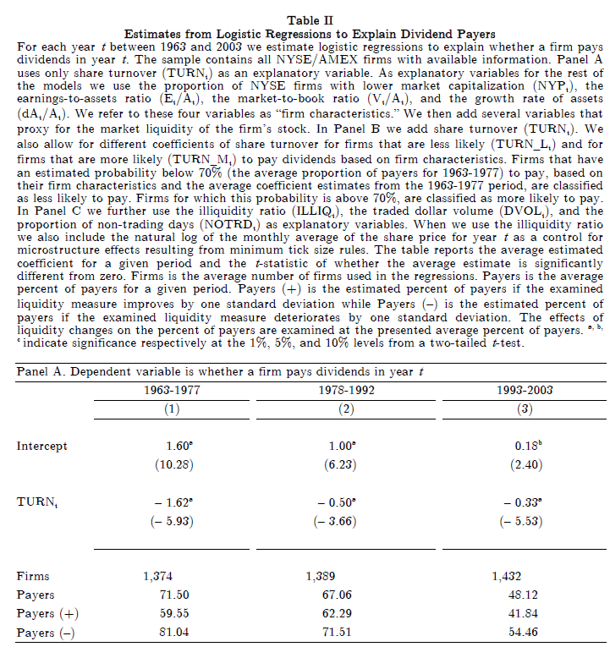
Empirical Result

Slide 8
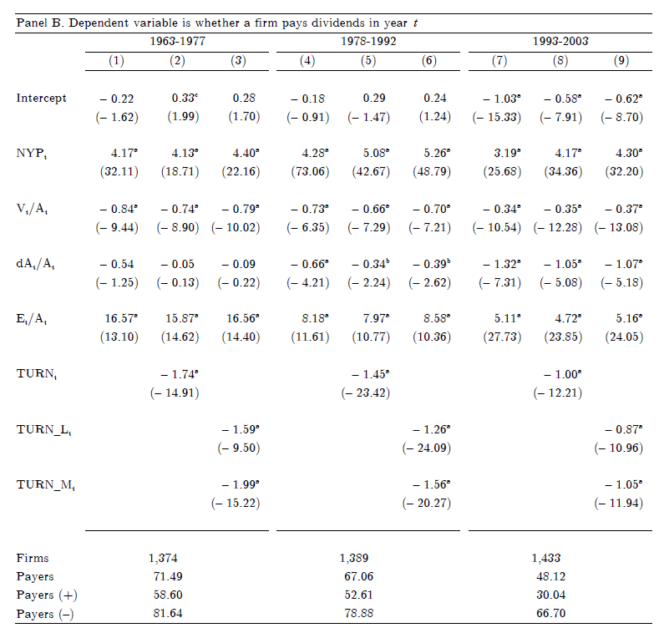

Slide 9
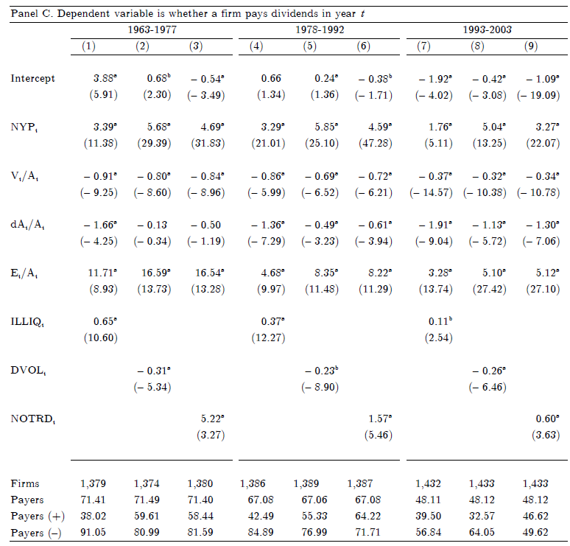

Slide 10
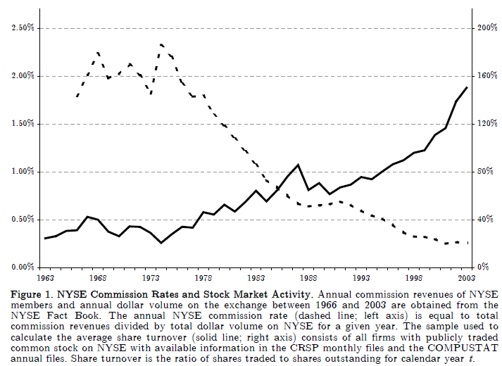
Empirical Result

Slide 11
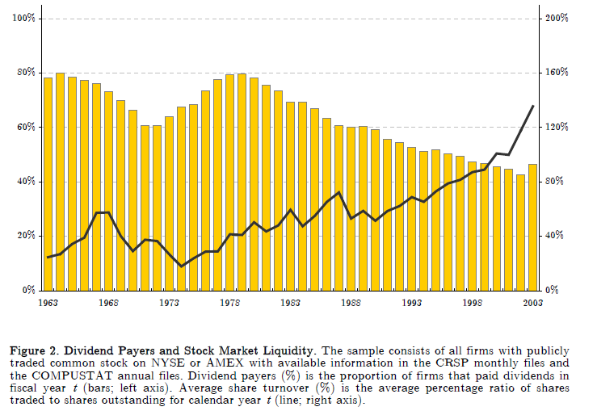
Empirical Result

Slide 12
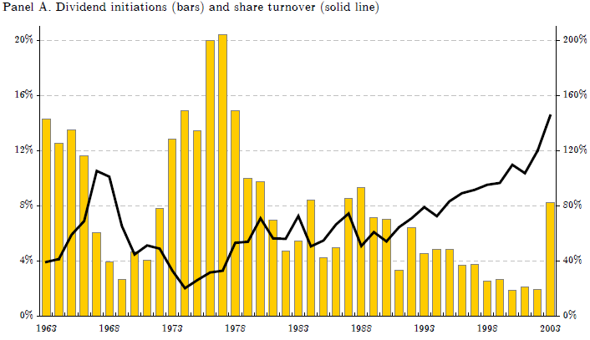
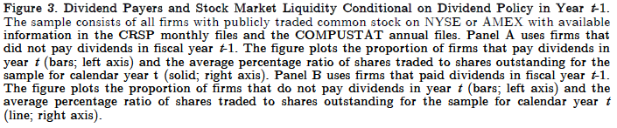
Empirical Result

Slide 13
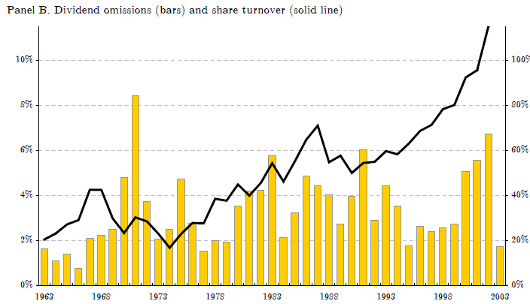
Empirical Result

Slide 14
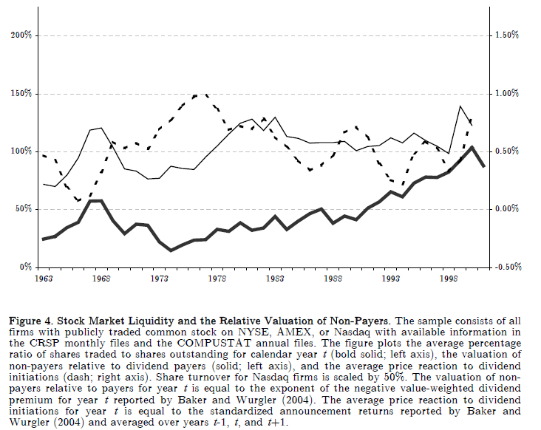
Empirical Result

Slide 15
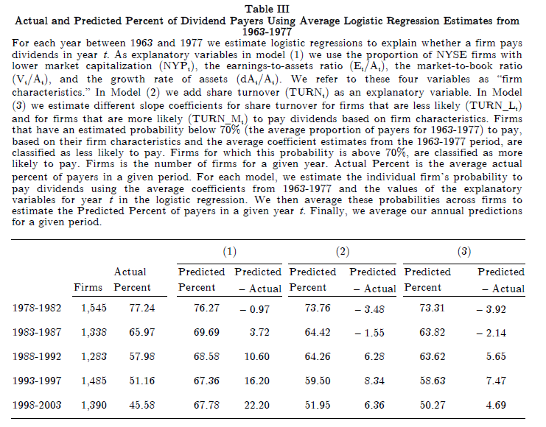
Empirical Result

Slide 16
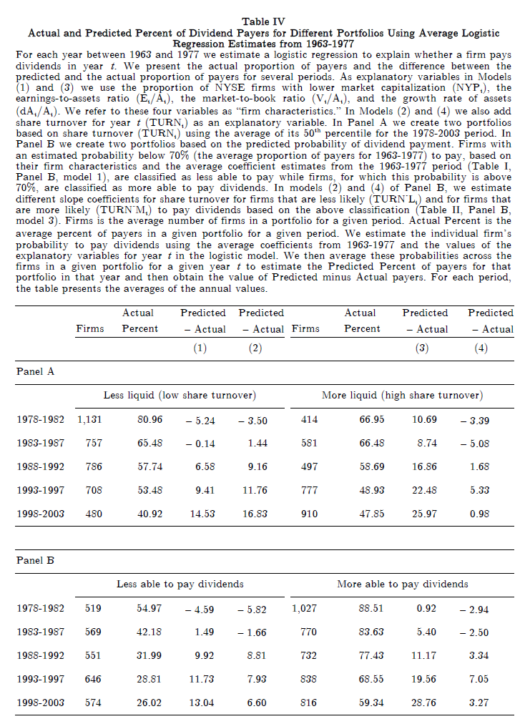
Empirical Result

Slide 17
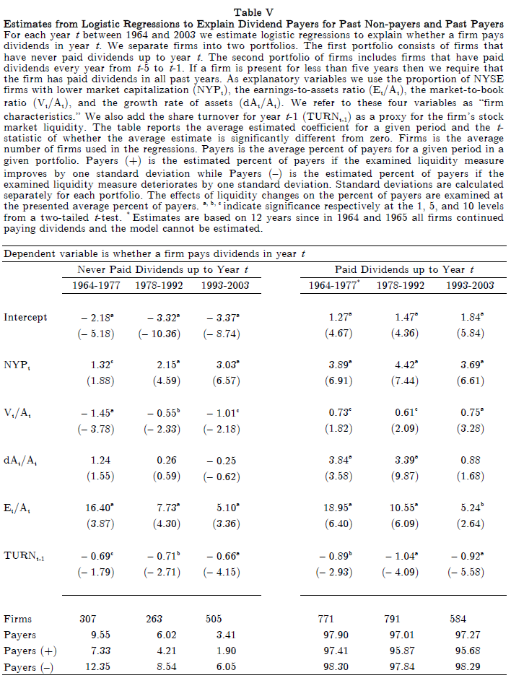
Empirical Result

Slide 18
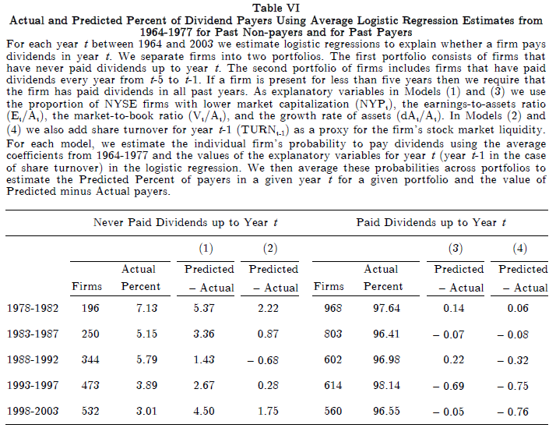
Empirical Result

Slide 19
Empirical Result: Robust Test
Repurchase
Do not affect the result here
Clienteles
Still the same result
ESO
Firms reserve more stock for conversion, are less likely to pay dividend.

Slide 20
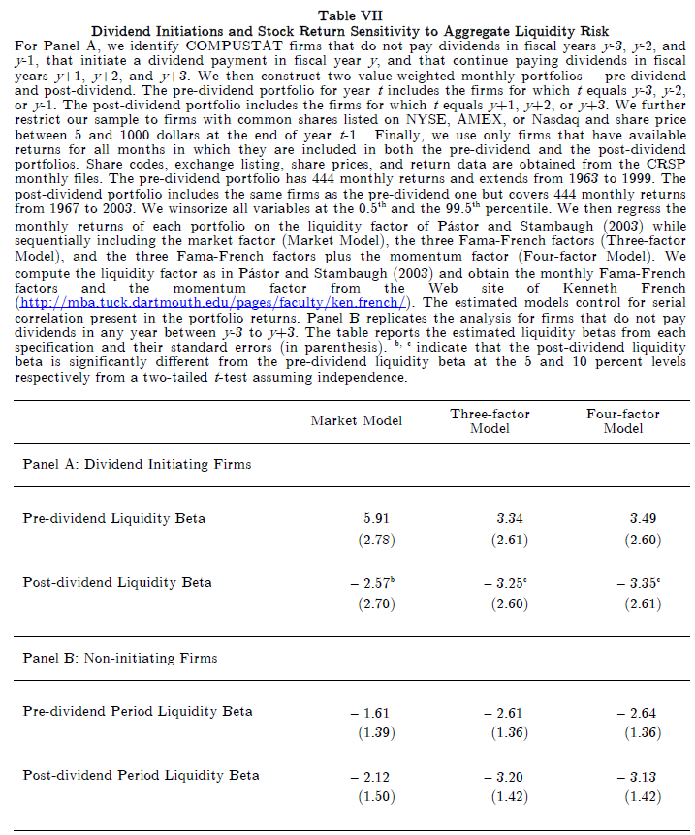
Empirical Result

Slide 21
Conclusion
Market Liquidity has negative relation with Dividend Payout.
Firms will pay dividend for catering the liquidity preference of investors
In other words, decline dividend payer can improve Market Liquidity
Firms can decline the sensitivity of Liquidity risk by Paying Dividend.

